Slide 1
Natural Language
Notes:
This module explores the relationship of AI to natural (i.e., ordinary) language. NL has always been part of AI but two things have have recently made an NL a key technology—if not part of our lives. The first is the recognition that machine learning is extraordinarily helpful for this field; the second (not entirely independent) is the fact that people have grown accustomed to speaking to devices.

Slide 2
NLP Learning Goals
Frame the NLP Enterprise
Enable Role of Grammars
Use Tools
Explore Logic Approaches
Leverage Neural Net Approaches

Slide 3
Natural Language
Introduction
Grammars
Tools
Logic Approaches
Neural Net Approaches
Notes:
We begin with discussions of analytical approaches to NL and cap this with the application of neural Nets.

Slide 4
NL Iput vs. Output
Input: Requires comprehension by the program
Output: ML generation
Our focus

Slide 5

Speech Act
Assume text
Adapted from Russell
Notes:
It can be useful to think of natural language in terms of “speech acts”—something that involves the source, the content, and the destination.

Slide 6
Speech Acts
Speaker → Utterance → Hearer
Example:
From an AI course, you can learn how to create intelligent applications. "Intelligent" means that the application's output is informed by human understanding.
Notes:
There is no preconceived limit to the content size of a speech act.

Slide 7
Some Types of Speech Acts
—achieve speaker’s goals
Inform: There’s a pit in front of you”
Query: Can you see the gold?
Command: …
Adapted from Russell & Norvig
Notes:
There are several kinds of speech acts as shown in the figure. And although they all contain words, they are very different.

Slide 8
Some Types of Speech Acts
—achieve speaker’s goals
Inform: There’s a pit in front of you”
Query: Can you see the gold?
Command: Pick it up
Promise: I’ll share the gold with you
Acknowledge: OK
Adapted from Russell & Norvig
Notes:
There are several kinds of speech acts as shown in the figure. And although they all contain words, they are very different.

Slide 9
Requires knowledge of …
Situation
Semantic and syntactic conventions
…
Make sure that you know the difference
Make sure that you know the difference
Adapted from Russell & Norvig
Notes:
Every speech act exists in some context—the same speech act can mean something entirely different in a different context. A sequence of words obeys syntactic conventions like programming languages: in other words, it must have a recognized format. At the same time, it must convey meaning—it’s semantics.

Slide 10
Requires knowledge of …
Situation
Semantic and syntactic conventions
Speaker’s (hearer’s?) …
goals,
knowledge base, and
rationality
Adapted from Russell & Norvig
Notes:
In addition to the context, semantics, and syntax, the better we understand the goals, knowledge, and reasoning of the hearer and of the speaker, the better we can interpret and process an utterance.

Slide 11
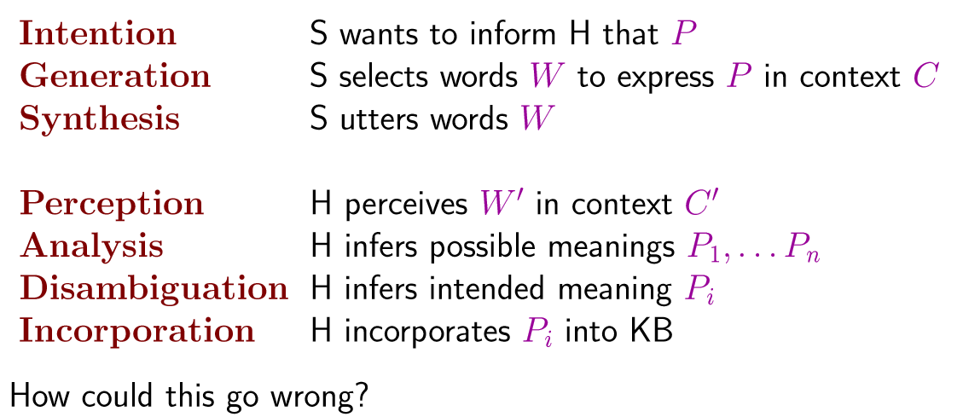
Stages of Informing: Speaker
Adapted from Russell & Norvig

Slide 12
Stages of Informing: Speaker
Adapted from Russell & Norvig

Slide 13
Stages of Informing: Speaker
Adapted from Russell & Norvig

Slide 14
Stages of Informing: Hearer
Adapted from Russell & Norvig
Notes:
The figure shows the roles of the speaker (S) and the hearer (H).

Slide 15
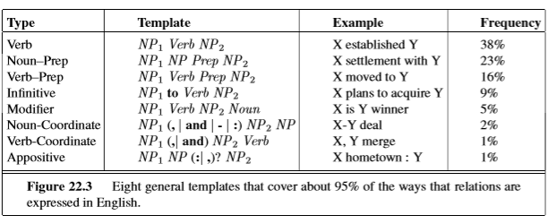
How Relations Are Expressed in English
Note analysis
from Russell & Norvig
Notes:
Continuing this analytic approach, we can measure how often a verb, for example, occurs, or a noun/preposition sequence such as “here of.”

Slide 16
How Relations Are Expressed in English
from Russell & Norvig

Slide 17
Natural Language
Introduction
Grammars
Tools
Logic Approaches
Neural Net Approaches
Notes:
This section reviews grammar in natural and formal language—its structure.

Slide 18
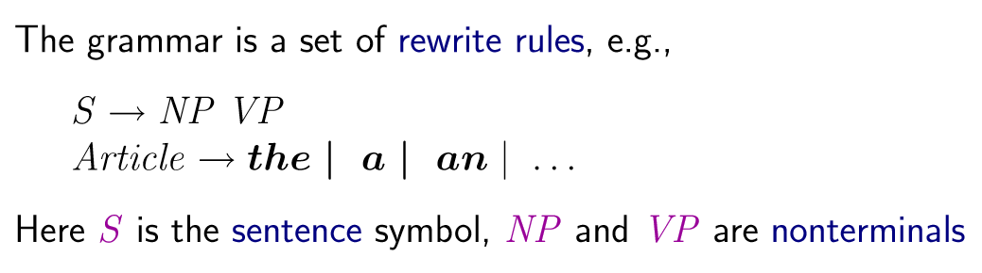
Grammars
Example: grammar G={S, p, q}, with productions
S → pSp,
S → qSq,
S → ε.
Typical derivation:
S → pSp → ppSpp → ppqSqpp → ppqqpp.
Adapted from Russell & Norvig
Notes:
A grammar is defined by a vocabulary—e.g., {S, p, q}—and a set of rewrite rules, as shown in the figure.

Slide 19
Grammars
(Backus Nauer Form)
Adapted from Russell & Norvig
Notes:
The figure shows a common rewrite rule. It says that every sentence consists of a noun phrase followed by a verb phrase. The symbols used for the latter are sufficient at this level (they are expressive, but you could use any symbols you want, actually.

Slide 20
Example*
Grammar for { a^{n}b^{n}c^{n} : n ≥ 1 } :
e.g., a³b³c³:
* https://en.wikipedia.org/wiki/Context-sensitive_grammar#Examples
Notes:
The figure shows they set of rewrite rules that specify expressions of the form a^{n}b^{n}c^{n}.

Slide 21
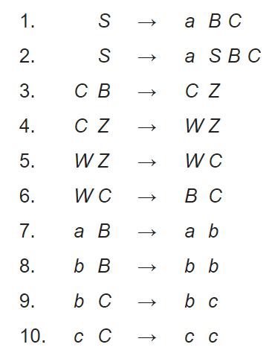
Example*
Grammar for { a^{n}b^{n}c^{n} : n ≥ 1 } :
e.g., a³b³c³:
* https://en.wikipedia.org/wiki/Context-sensitive_grammar#Examples
Notes:
The figure shows they set of rewrite rules that specify expressions of the form a^{n}b^{n}c^{n}.

Slide 22
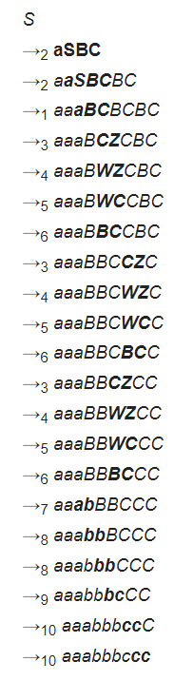
Example*
Grammar for { a^{n}b^{n}c^{n} : n ≥ 1 } :
e.g., a³b³c³:
* https://en.wikipedia.org/wiki/Context-sensitive_grammar#Examples
Notes:
The figure shows they set of rewrite rules that specify expressions of the form a^{n}b^{n}c^{n}.

Slide 23
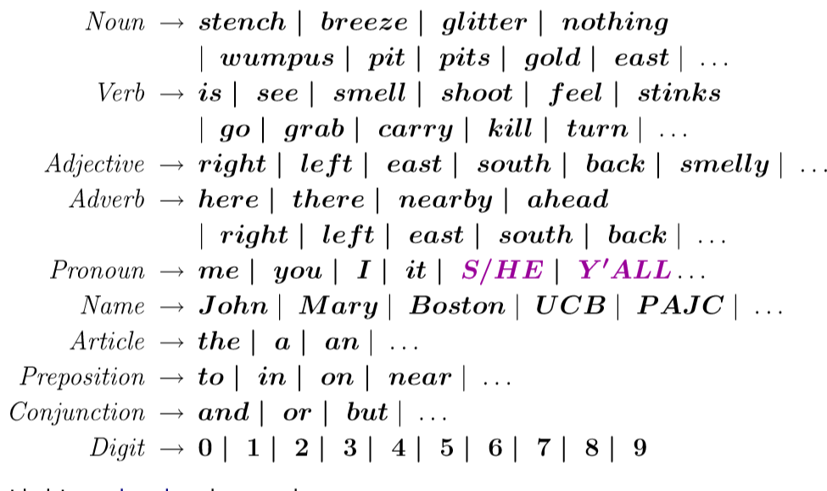
Example: Wumpus World Lexicon
Continued →
Adapted from Russell & Norvig
Notes:
These figures show the complete grammar for Wumpus World. The first shows the terminals and the second the nonterminals.

Slide 24
Example: Wumpus World Lexicon
Continued →
Adapted from Russell & Norvig
Notes:
These figures show the complete grammar for Wumpus World. The first shows the terminals and the second the nonterminals.

Slide 25
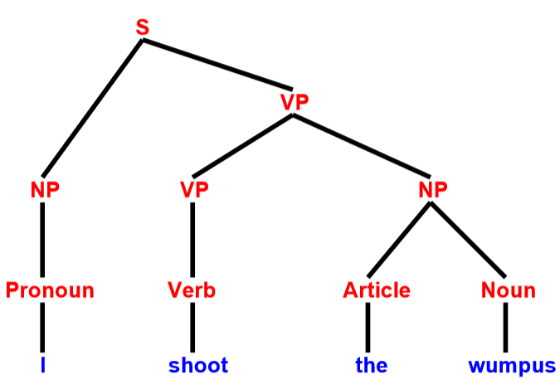
Wumpus NL Parse Tree Example
Adapted from Russell & Norvig
Notes:
Russell and Norvig developed a simple language for Wumpus World, typified by the figure.

Slide 26
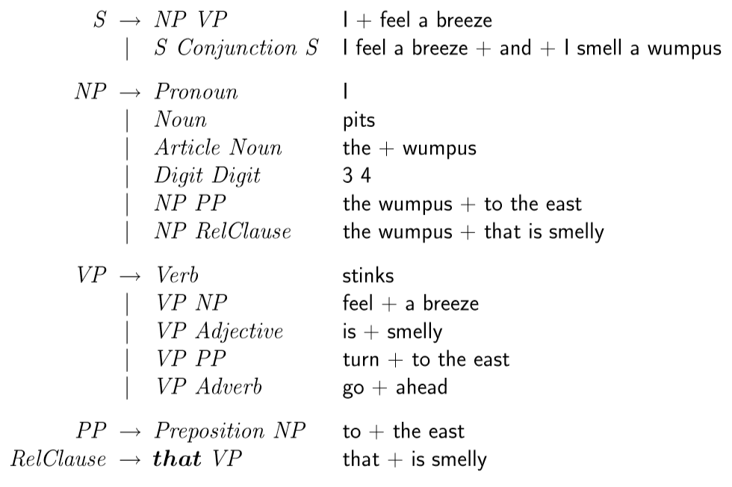
Wumpus World Grammar
Grammar ctd.
Example
Adapted from Russell & Norvig

Slide 27
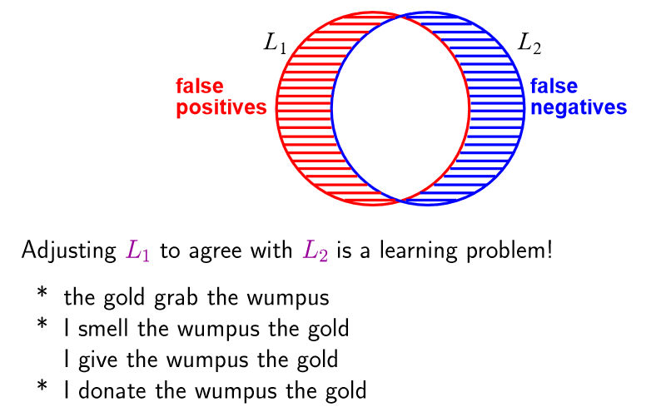
Comparing Formal (L1) & Natural (L2) Language
Adapted from Russell & Norvig
Notes:
The figure shows typical problems with using a grammar for natural language. There are natural language utterances which make good sense to humans but which the grammar can’t parse (false negatives); conversely, there are expressions which the grammar can parse but which make no sense in the real world (false positives).

Slide 28
Comparing Formal (L1) & Natural (L2) Language
Adapted from Russell & Norvig
Notes:
The figure shows typical problems with using a grammar for natural language. There are natural language utterances which make good sense to humans but which the grammar can’t parse (false negatives); conversely, there are expressions which the grammar can parse but which make no sense in the real world (false positives).

Slide 29
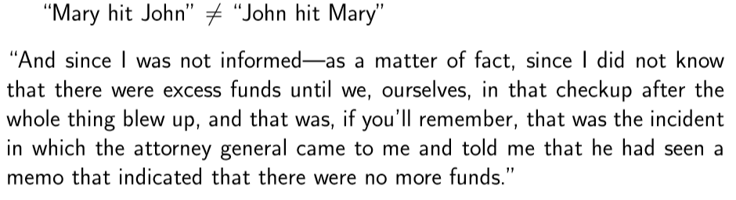
Syntax ➔ Meaning in NL?
Adapted from Russell & Norvig
Notes:
It is one thing to recognize the legality of an utterance according to a grammar but that is just the beginning: we still need to assign meaning to the utterance. In other words, the utterance must belong within the real world. That typically means connecting it with concepts already known to users (readers, listeners etc.).

Slide 30
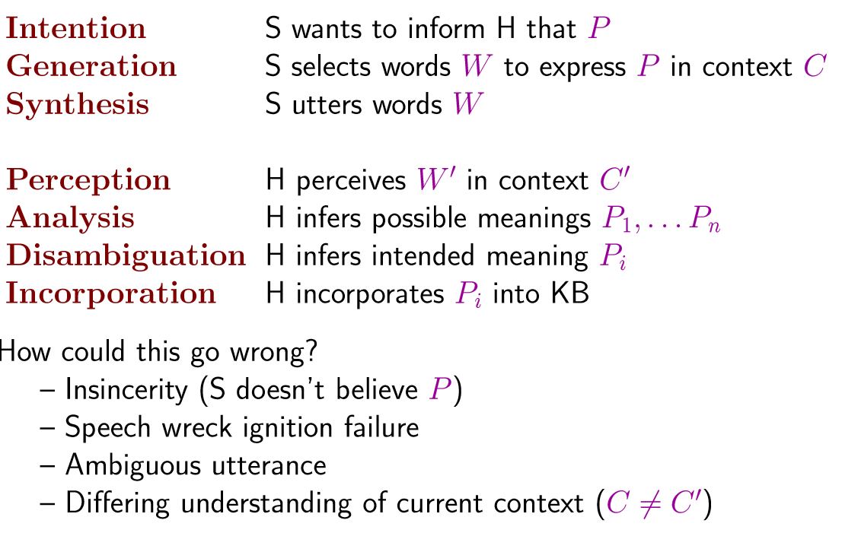
Recall the Wide Variety of Contexts!
Adapted from Russell & Norvig
Notes:
The figure reminds us that there can be several—perhaps many—contexts for an utterance. Parsing does not distinguish them well—if at all.

Slide 31
Natural Language
Introduction
Grammars
Tools
Logic Approaches
Neural Net Approaches
Notes:
Tools for dealing with natural language have multiplied on the Web.

Slide 32
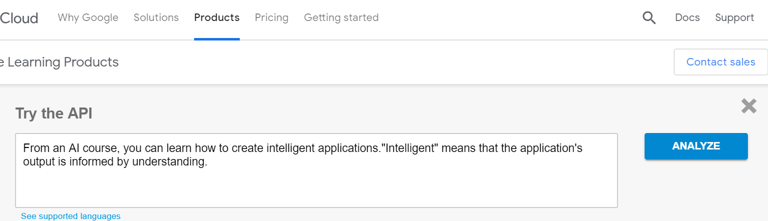
Entities in an Utterance (Google)
https://cloud.google.com/natural-language/
Notes:
A good example of a tool is from Google, where the figures show a typical analysis session. It goes well beyond syntax, and provides semantic options.

Slide 33
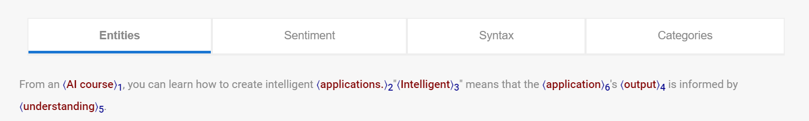
Analyses

Slide 34
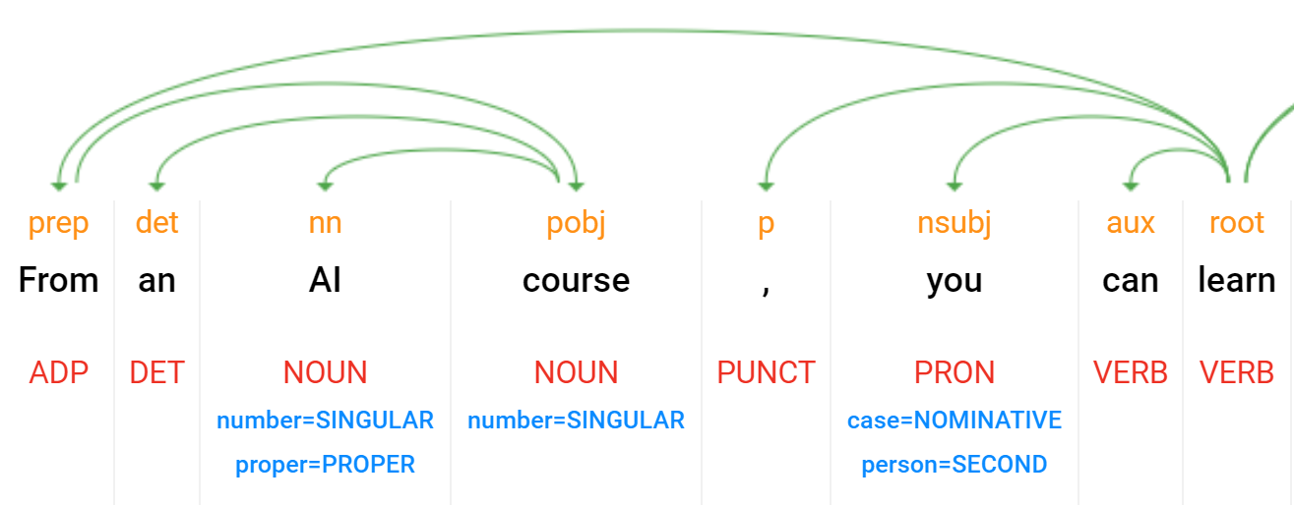
Google N-L: Parsing Example—First Part
Notes:
This figure shows its enhanced parsing.

Slide 35
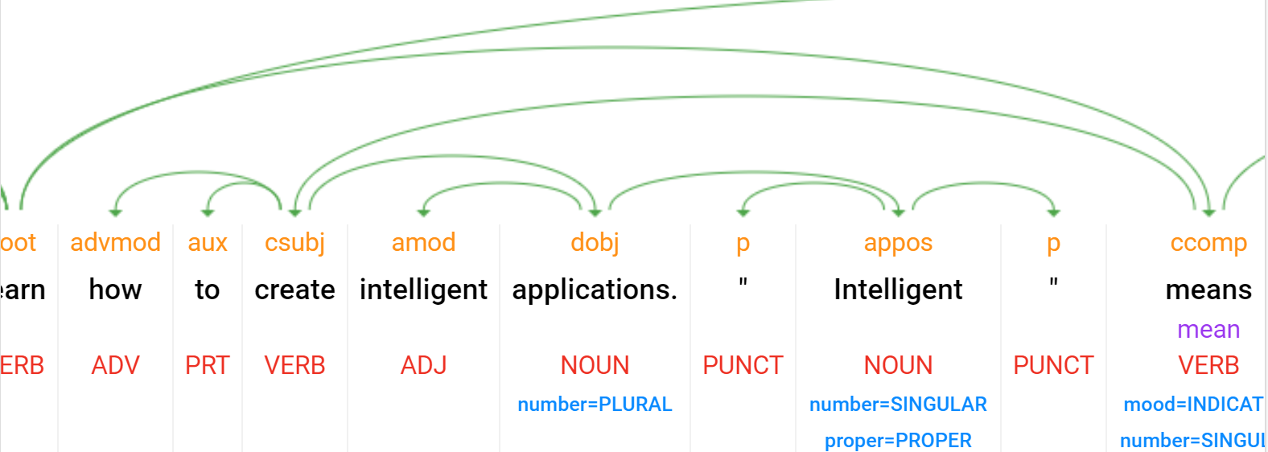
Google N-L: Parsing Example—Second Part

Slide 36
Sentiment Analysis for a Document
score → overall emotion: -1.0 (negative) to 1.0 (positive)
magnitude → strength of emotion (both positive and negative): 0.0 to +inf
often proportional to length
Adapted from https://cloud.google.com/natural-language/docs/basics#interpreting_sentiment_analysis_values
Notes:
To handle semantics in the real world, it is often useful to understand how the user is feeling. This is partially captured by sentiment analysis.

Slide 37
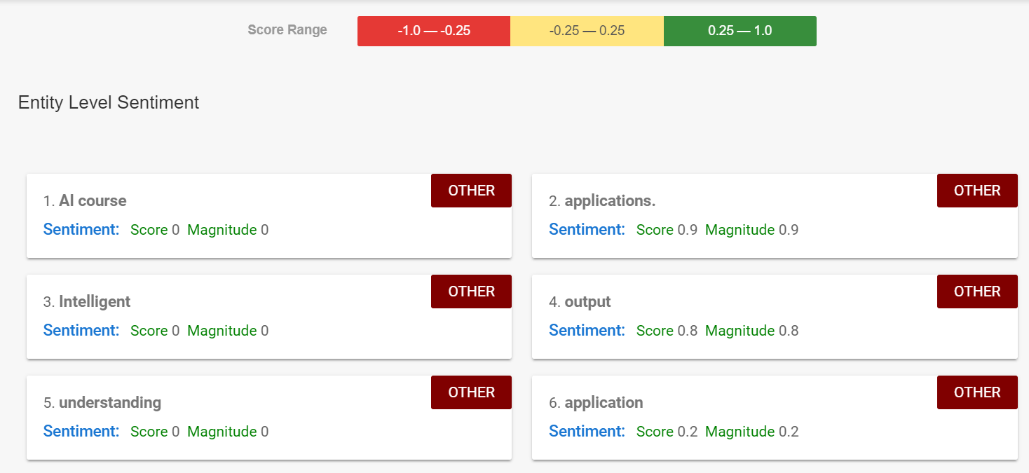
Google N-L: Sentiment Analysis
Notes:
The color coding etc. can be translated into useful API’s, enabling a degree of natural language understanding to be integrated into applications.

Slide 38
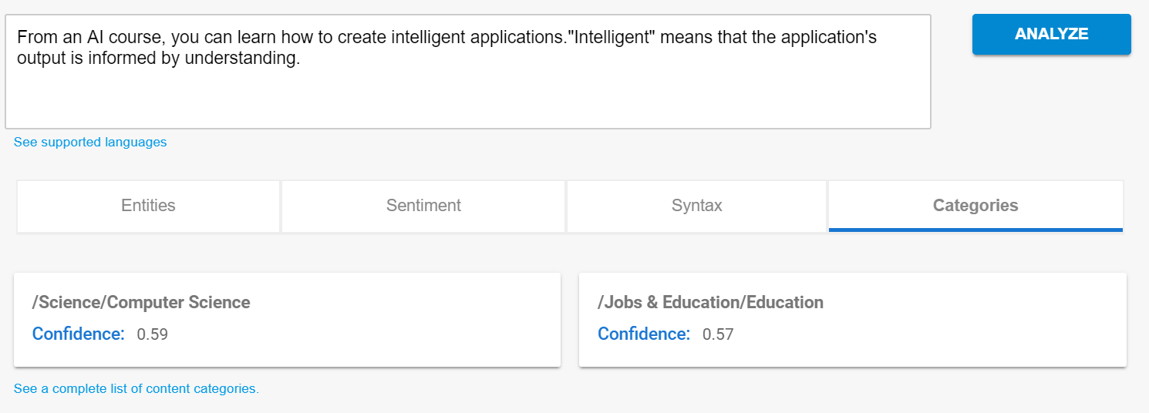
Categorization
Notes:
Tools like this are a reminder that there are many aspects to semantics. For example simply categorizing an utterance can be much of what is needed for a given application. Word by word semantic analysis maybe unnecessary.

Slide 39
Application: TEXTRUNNER
Achieves precision of 88% and recall of 45% (F1 of 60%) on a large Web corpus.
Has extracted hundreds of millions of facts from a corpus of a half-billion Web pages.
E.g., …
Adapted from Russell & Norvig
Notes:
There are many natural language applications, textrunner being one. The utility of a natural language analyzer is highly dependent on what will be done with the results. For example, whether we can deal with the error that water kills bacteria.

Slide 40
Application: TEXTRUNNER
Achieves precision of 88% and recall of 45% (F1 of 60%) on a large Web corpus.
Has extracted hundreds of millions of facts from a corpus of a half-billion Web pages.
E.g., even though it has no predeﬁned medical knowledge, it has extracted over 2000 answers to what kills bacteria. Correct answers include antibiotics, ozone, chlorine, Cipro, and broccoli sprouts. Questionable answers include “water,” which came from the sentence “Boiling water for at least 10 minutes will kill bacteria.”
https://openie.allenai.org/
Adapted from Russell & Norvig
Notes:
There are many natural language applications, textrunner being one. The utility of a natural language analyzer is highly dependent on what will be done with the results. For example, whether we can deal with the error that water kills bacteria.

Slide 41
How This Can Go Wrong?
Adapted from Russell & Norvig
Notes:
As mentioned above, there are many contexts for utterances. Natural language systems may not recognize them. Humans can be good at detecting sincerity or ambiguity whereas it is often believed that natural language systems have a harder time with this.

Slide 42
Example API: TextRazor
https://www.textrazor.com/
Adapted from Russell & Norvig
Notes:
TextRazor is an example of a natural language API. An example follows.

Slide 43
TextRazor Example: Input
Barclays misled shareholders and the public about one of the biggest investments in the bank's history, a BBC Panorama investigation has found.
The bank announced in 2008 that Manchester City owner Sheikh Mansour had agreed to invest more than £3bn.
But
...
Neither Sheikh Mansour nor IPIC responded to questions raised by Panorama.
In August last year, the UK's Serious Fraud Office said it had started an investigation into commercial arrangements between the bank and Qatar Holding LLC, part of sovereign wealth fund Qatar Investment Authority.
https://www.textrazor.com/demo

Slide 44
TextRazor Example Output: Categories
0.93
economy, business and finance>economy>macro economics>investments
0.72
economy, business and finance>business information>business finance>shareholder
0.70
economy, business and finance>economy
0.64
economy, business and finance>market and exchange>securities
0.49
crime, law and justice>law
…
https://www.textrazor.com/demo

Slide 45
TextRazor Example Output: Topics
1.00
Barclays
1.00
Mansour bin Zayed Al Nahyan
1.00
Qatar Investment Authority
1.00
Finance
1.00
Economy
1.00
…
https://www.textrazor.com/demo

Slide 46
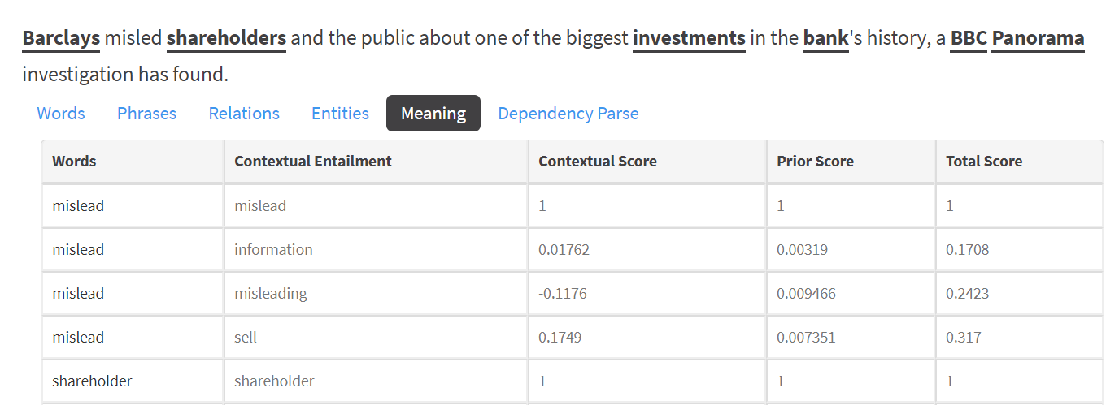
TextRazor Example Output: Meaning
Contextual entailment “captures relations of consequence, resolution, presupposition, and dependency which hold not purely logically, but against the background of a specific context.”
https://link.springer.com/article/10.1007/s11229-016-1221-y#:~:text=Contextual%20entailment%20captures%20relations%20of,background%20of%20a%20specific%20context.&text=Focusing%20on%20dependency%2C%20let%20us,instance%20of%20entailment%20in%20context.

Slide 47
Python NLTK for NL Text Processing
http://text-processing.com/demo/
Sentiment Analysis:
e.g., “I hate Churchill”
Tokenizing
Stemming
Tagging
Notes:
The natural language toolkit http://text-processing.com/demo/ can be tried out online.

Slide 48
Natural Language
Introduction
Grammars
Tools
Logic Approaches
Neural Net Approaches
Notes:
Before we get to machine learning approaches to NLP, we discuss one more family of approaches based on formal grammars.

Slide 49
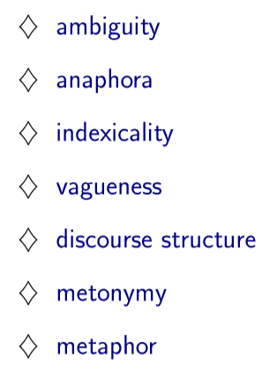
Natural Language, Realistically
the use of a word referring to or replacing a word used earlier in a sentence
words, such as "I" or "here", that can have different meanings depending on who is saying them
substitution of the name of an attribute or adjunct for that of the thing meant, e.g., suit for business executive, or the track for horse racing.
Adapted from Russell & Norvig
Notes:
We’ve discussed some of the characteristics of natural language that are not found in pure logic. The figure shows more of them.

Slide 50
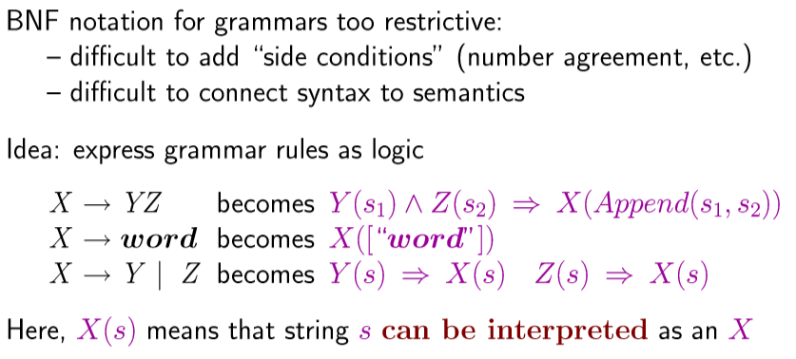
Need More Than Backus Nauer Form
Adapted from Russell & Norvig
Notes:
The rewrite rules that we’ve been using are known as Backus-Nauer form.

Slide 51
Need More Than Backus Nauer Form
Adapted from Russell & Norvig
Notes:
One approach is to use classical logic instead of production rules. In this case we can be more flexible. For example, instead of saying produces X we can say can be interpreted as an X. In other words, we’re using predicates (of which we will say more later).

Slide 52
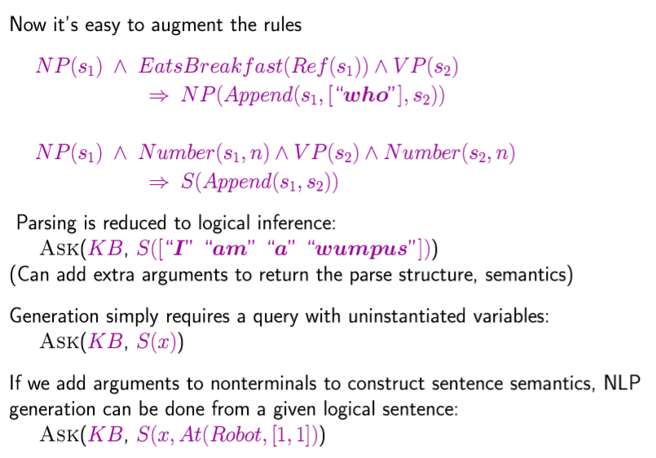
Augmented Rules using FOL
If s₁ (e.g., Raymond) is interpreted as a noun phrase and reference
and the result is interpreted as eating breakfast
and s₂ (e.g., was eating) is interpreted as a verb phrase
then s₁ who s₂ (Raymond who was eating) can be interpreted as a noun phrase.
Adapted from Russell & Norvig
Notes:
This example says if s₁ is interpreted as a noun phrase … But notice that we can add another implication if s₁ is interpreted as <something else>, and thus build alternative ways to process NL.

Slide 53
Querying the Knowledge Base (KB)
Adapted from Russell & Norvig
Notes:
The idea is to leverage automated logic processing, which been quite successful in recent years.

Slide 54
Natural Language
Introduction
Grammars
Tools
Logic Approaches
Neural Net Approaches

Slide 55
NLP via Neural Nets
Yoav Goldberg
“… neural network models started to be applied also to textual natural language signals, again with very promising results. … input encoding for natural language tasks, feed-forward networks, …
https://www.jair.org/index.php/jair/article/view/11030/26198
Notes:
It is ironic that after years of natural language analysis, a simpler but massive alternative has turned out to be remarkably successful: using machine learning and a corpus of utterances in various contexts.

Slide 56
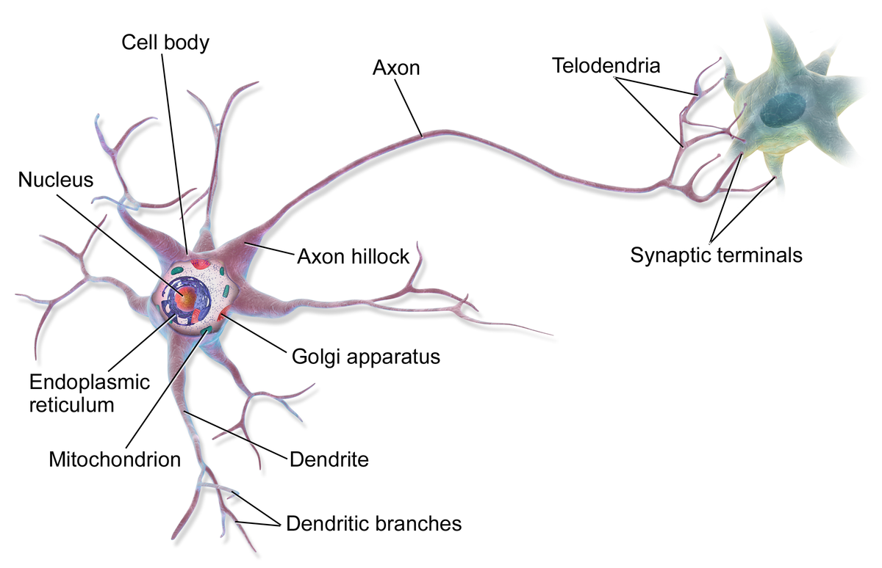
Neural Nets: What?
A problem-solving technique that simulates neurons and their interaction.
https://en.wikipedia.org/wiki/Neuron
Notes:
Neural nets are based on aspects of the brain. A Neural net consists of neurons—cells that take input from and provide output to other neurons. Importantly, a single neuron does not seem to encode knowledge as we understand it. Knowledge is encoded by the set of connections between neurons.

Slide 57
Modelling Neuronal I/O
* Output =
f (wo + w’o’)
*
*
*
Process
Transfer function
input wo+w’o’
weight w
weight w’
Notes:
In software, we model each connection with a number (the weight) that reflects its relative strength.
Each neuron in a neural net takes as input the sum of a output of other neurons, weighted by the connection strength. It then applies a function (a transfer function) to this quantity. The output of this function becomes an input to other neurons (after weighting), or else it is the output to the whole neural net.

Slide 58
Modelling Neuronal I/O
Process
Process
Process
*
*
*
Process
Neuron simulation
input wo+w’o’
weight w
weight w’
output o
output o’
Process
Process
Notes:
This figure shows how a (simulated) neuron interacts with other neurons.
As with (what we know about) biological neural networks, learning consists mainly of modifying weights.

Slide 59
Google Translate Technical Architecture
Neural machine translation (NMT) … machine translation that uses a large artificial neural network to predict the likelihood of a sequence of words, typically modeling entire sentences in a single integrated model.
Deep neural machine … multiple neural network layers ...^{[1]}
https://en.m.wikipedia.org/wiki/Neural_machine_translation
Notes:
One success, for example, has been Google Translate. This was a natural first target because there is a large corpus of input output data.

Slide 60
“NEURAL MACHINE TRANSLATION …*”
… encode a source sentence into a fixed-length vector from which a decoder generates a translation. …
* https://arxiv.org/pdf/1409.0473.pdf Bahdanau, Cho, and Bengio
Notes:
The original paper describes the use of fixed length vectors.

Slide 61
“NEURAL MACHINE TRANSLATION …*”
… encode a source sentence into a fixed-length vector from which a decoder generates a translation.
… automatically search for parts of a source sentence that are relevant to predicting a target word,
… achieve a translation performance comparable to the existing state-of-the-art phrase-based system on the task of English-to-French translation. …
* https://arxiv.org/pdf/1409.0473.pdf Bahdanau, Cho, and Bengio

Slide 62
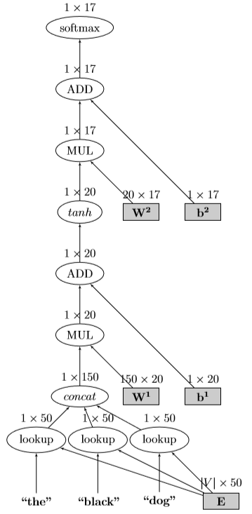
A Neural Net Architecture for Natural Language: First Convert Words*
* (partial) http://www.jair.org/index.php/jair/article/view/11030
Notes:
Neural nets deal with numbers (within vectors) so the first order of business is to convert words into numerical code.

Slide 63
A NN Architecture for Natural Language*
* (partial) http://www.jair.org/index.php/jair/article/view/11030
Notes:
Neural Nets typically have multiple levels. The example shown has 7 hidden (neither input nor output) layers. It shows the type of activation at each level.

Slide 64
Google Translate Example
Now is the winter of our discontent.
Made glorious summer by this sun of York
English → Dutch (for example) → English
Notes:
A breakthrough occurred when Google Translate was used on a passage from language A to language B and the result back to language A. Even for a nontrivial passage, the two versions were surprisingly comparable. An example is shown in the figures.

Slide 65
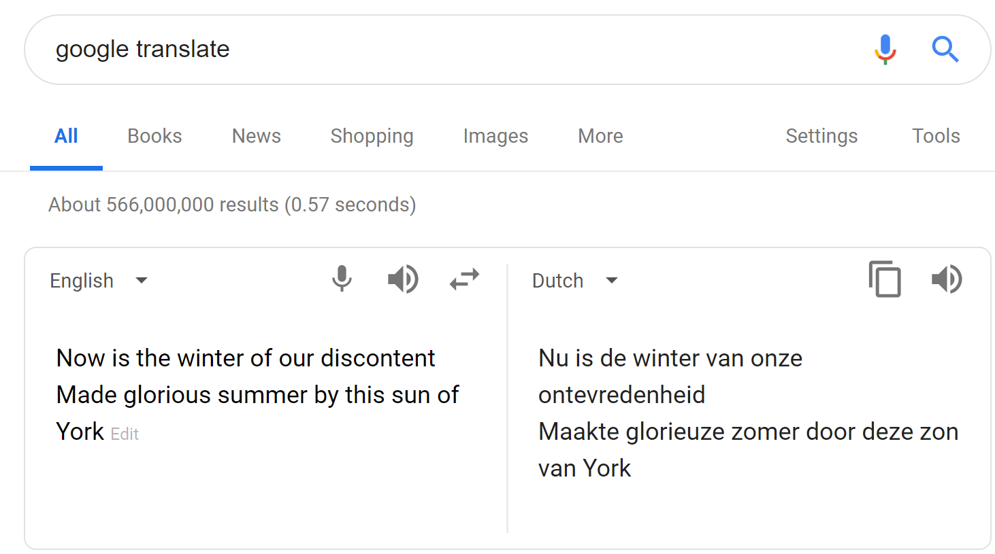
Example: Google Translate

Slide 66
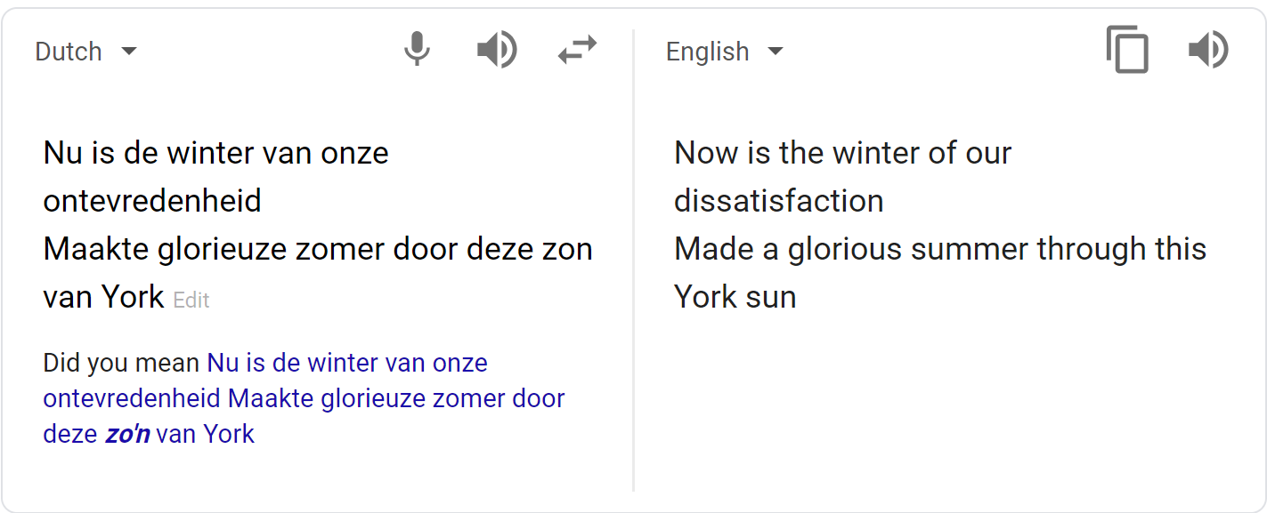
Example: Google Translate

Slide 67
NLP Summary
Substantial enterprise
Grammars have role
Tools prevalent
Logic approaches may help
Neural net approaches ascendant
Notes:
To summarize: natural language has become a major application area of AI in the real world. Although grammars continue to have a role, API’s have become prevalent, and the neural net approach, leveraging existing text, is the dominating approach.

